Slide 1
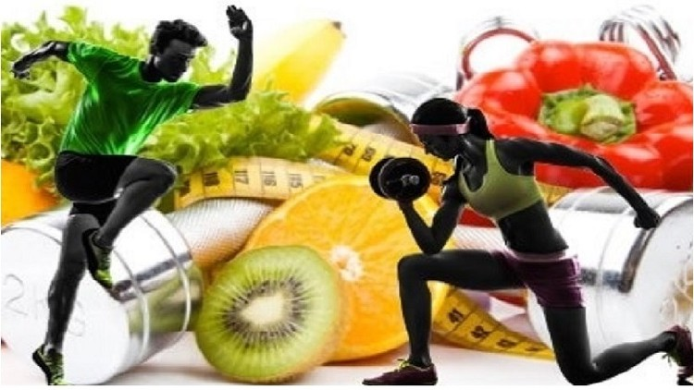
Sports Nutrition

Slide 2
INTRODUCTION
Sports nutrition is the study and practice of nutrition and diet with regards to improving anyone's athletic performance.
Nutrition is an important part of many sports training regimens, being popular in strength sports (such as weightlifting and bodybuilding) & endurance sports(e.g. cycling, running, swimming, rowing).
Sports nutrition focuses its studies on the type, as well as the quantity of fluids and food taken by an athlete.
In addition, it deals with the consumption of nutrients i.e vitamins, minerals, supplements & organic substances that include carbohydrates, proteins and fats.

Slide 3
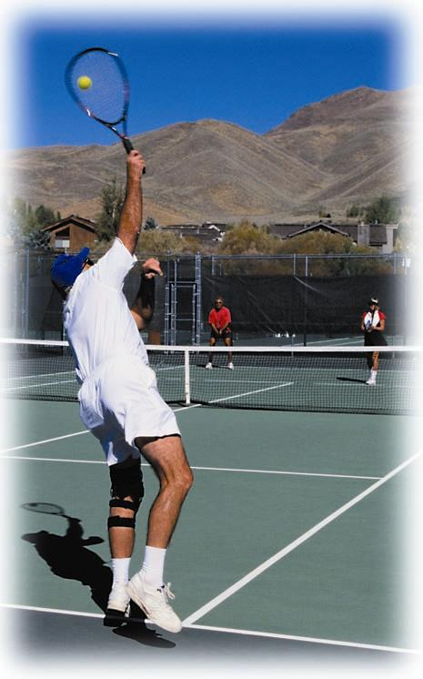
Nutrition and Physical Performance
“Exercise is medicine”
Physical fitness
  Cardiorespiratory fitness
  Muscular strength
  Muscular endurance
  Body composition
  Flexibility
Photos © PhotoDisc
Notes:
3

Slide 4
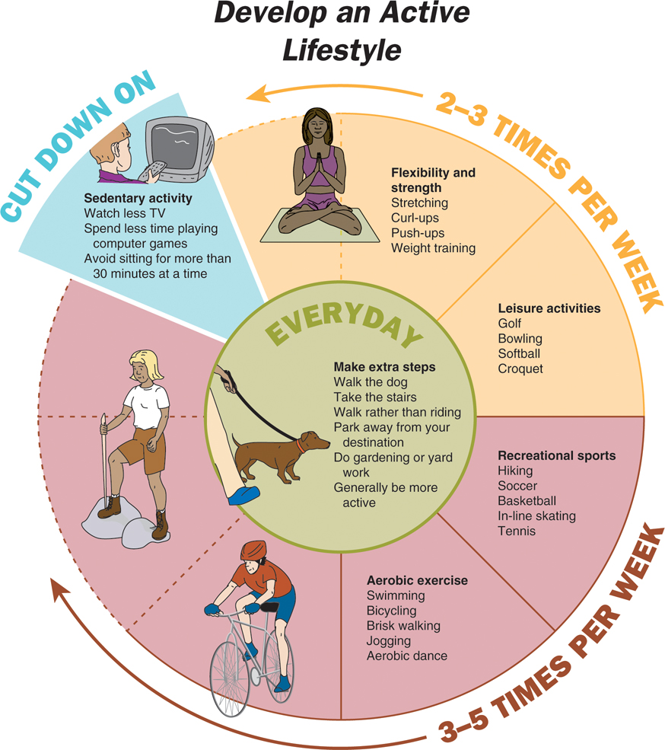
Develop an Active Lifestyle
Notes:
4

Slide 5
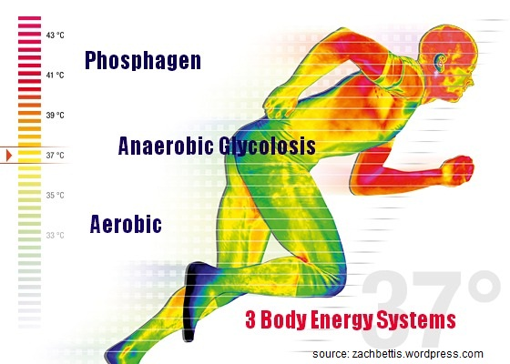
ENERGY SYSTEMS FOR ATHLETE'S

Slide 6
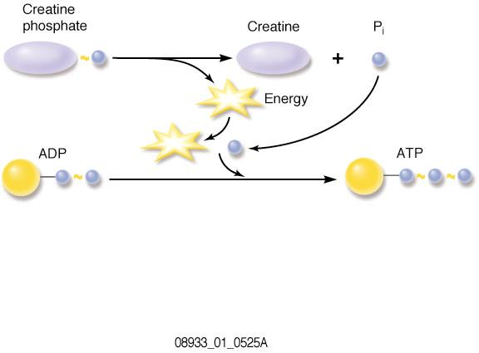
Energy Systems, Muscles, and Physical Performance
ATP-CP energy system
  Quick source of ATP
    Cellular ATP and creatine phosphate
  Fuel for 3 to15 seconds of maximal effort
Notes:
6

Slide 7
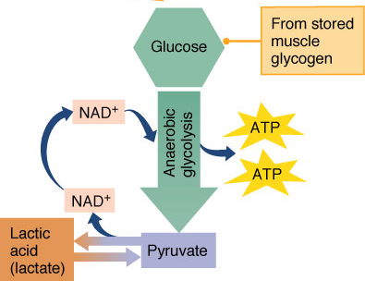
Energy Systems, Muscles, and Physical Performance
Lactic acid energy system
  Breakdown of glucose to lactic acid (lactate)
    Doesn’t require oxygen
  Rise in acidity triggers
  muscle fatigue
Notes:
7

Slide 8
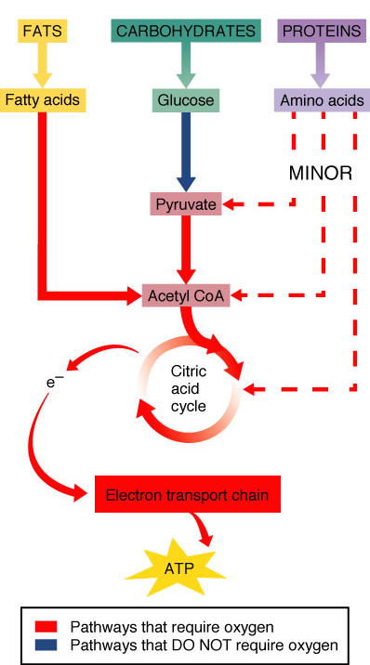
Energy Systems, Muscles, and Physical Performance
Oxygen energy system
  Breakdown of carbohydrate
  and fat for energy
    Requires oxygen
    Produces ATP more slowly
Notes:
8

Slide 9
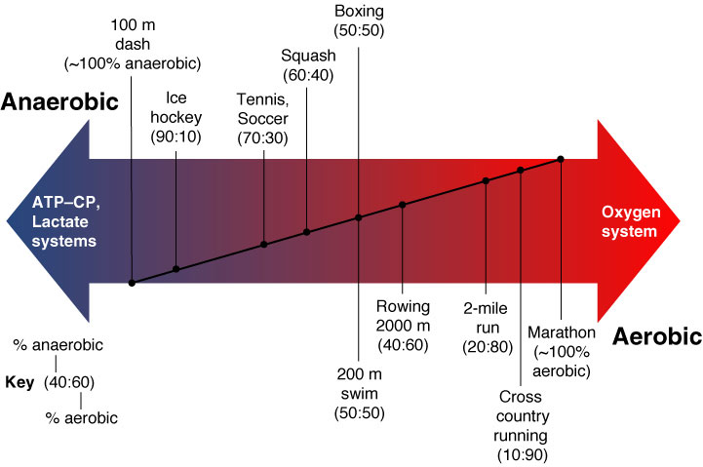
Energy Systems, Muscles, and Physical Performance
Teamwork in energy production
  Anaerobic systems
  Aerobic systems
Glycogen depletion
  Steady drop for first 1.5 hours
  Entirely depleted ~ 3 hours
Notes:
9

Slide 10
Energy Systems, Muscles, and Physical Performance
Endurance training
  Decreases reliance on anaerobic systems
  Extends availability of glycogen
Notes:
10

Slide 11
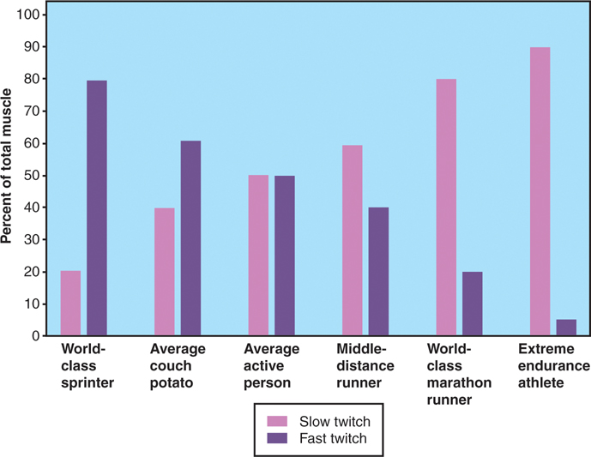
Energy Systems, Muscles, and Physical Performance
Muscles and muscle fibers
  Slow-twitch fibers
  Fast-twitch fibers
    Relative proportion determined by genetics
Notes:
11

Slide 12
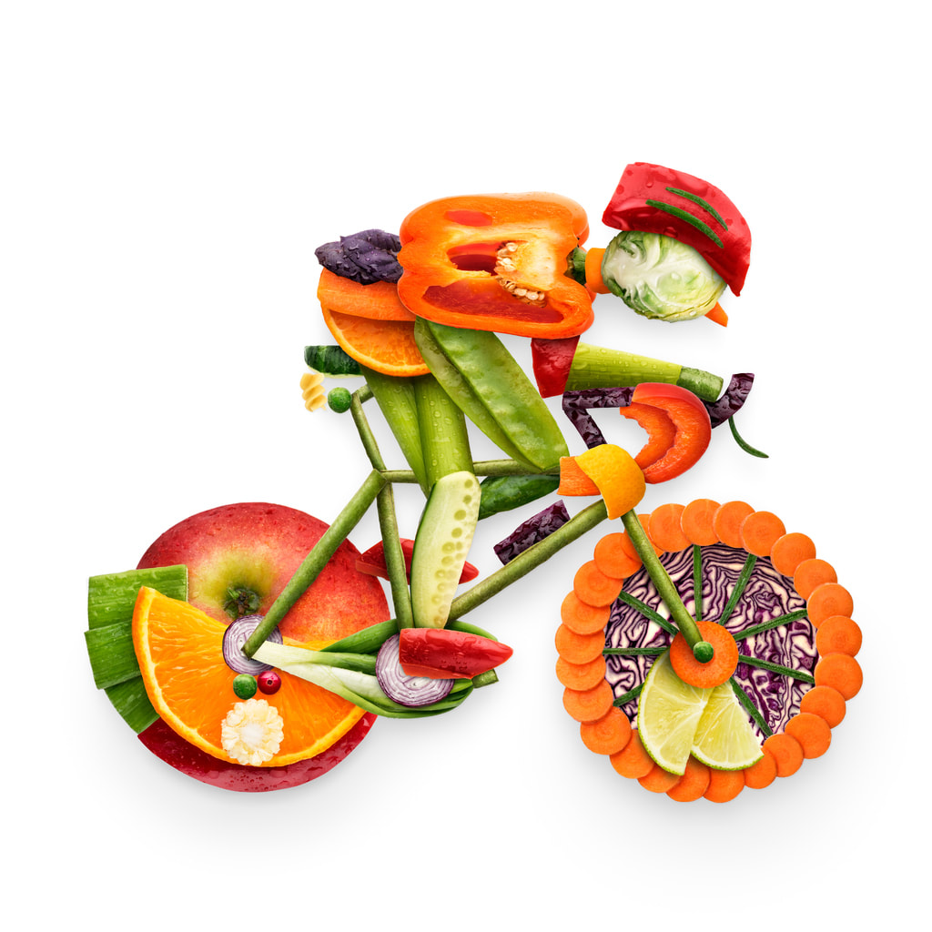
Optimal Nutrition for Athletic Performance
Consume adequate energy and nutrients
Maintain appropriate body composition
Promote optimal recovery from training
Maintain hydration status
Notes:
12

Slide 13
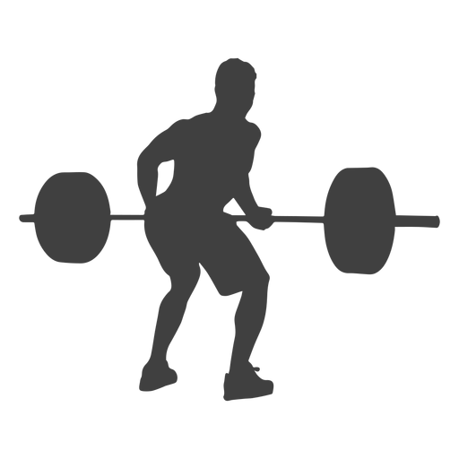
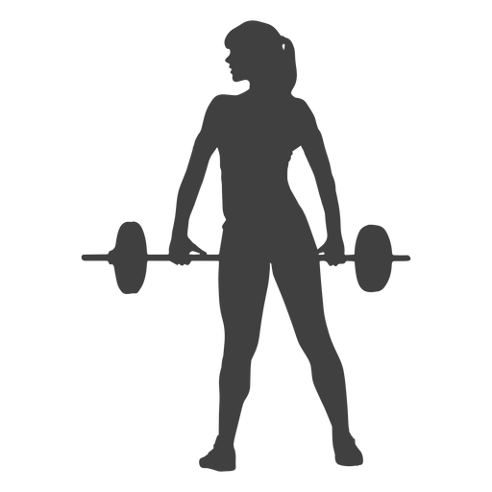
Dietary Principles Of Sports Nutrition
High Energy,
High Carbohydrate (Specially Simple Sugar During Event),
High Protein (High BV),
Moderate Fat (Maintain PUFA & MUFA Ratio),
Maintain Vitamin (C) & Minerals (Na, K),
Liberal Fluid ( Minimum 4 L),
With Increased Antioxidant.

Slide 14
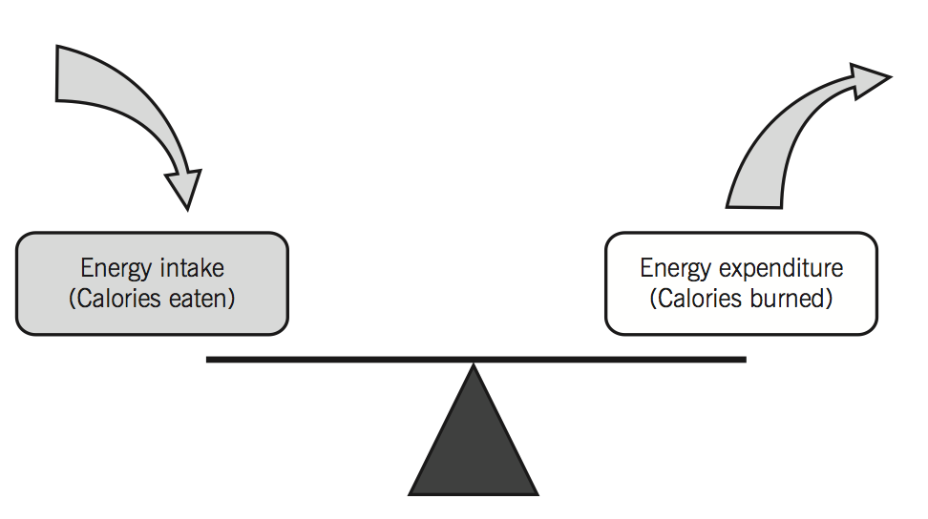
Energy Intake and Exercise
Energy needs
  Fuel for training
  Maintain healthy weight
  Support growth (if adolescent)
  May require frequent meals and snacks
  Total calorie requirements may range from 3000-5000 kcal/day.
Notes:
14

Slide 15
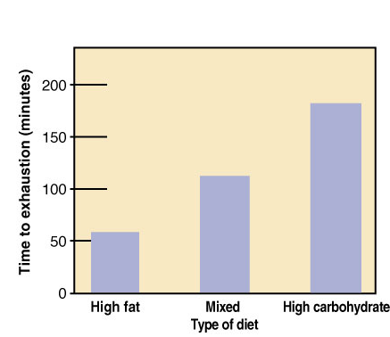
Carbohydrate and Exercise
High-carbohydrate diets
  Increase glycogen stores
  Extend endurance
Carbohydrate loading
  60–70% of calories as carbohydrate
  Decrease exercise intensity prior to competition
Notes:
15

Slide 16
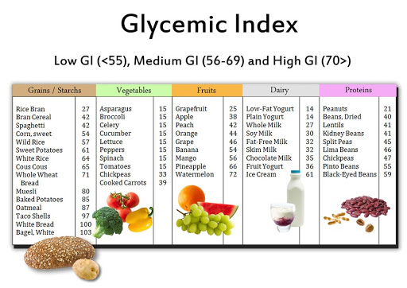
Carbohydrate and Exercise
Carbohydrate intake
  Before exercise
    Easily digested foods/beverages
  Pre-exercise meals and glycemic index
    Measure food to monitor its effects, which can raise blood glucose
Notes:
16

Slide 17
Carbohydrate and Exercise
  During exercise
    Sports drinks (4–8% carbohydrate)
  After exercise
    Replenish glycogen stores
      1 to 1.5 grams carbohydrate per kg both 30 minutes and 2 hours after exercise
Notes:
17

Slide 18
PREGAME CABOHYDRATE INTAKE
According to COSTIL (1977)Carbohydrate intake before exercise (45 min prior) lead to senseless condition.
HYPERGLYCEMIA
SENSELESS CONDITION
HYPERINSULINEMIA
SHARP DROP IN BLOOD GLUCOSE
INCREASE GLUCOSE UPTAKE
HYPOGLYCEMIA

Slide 19
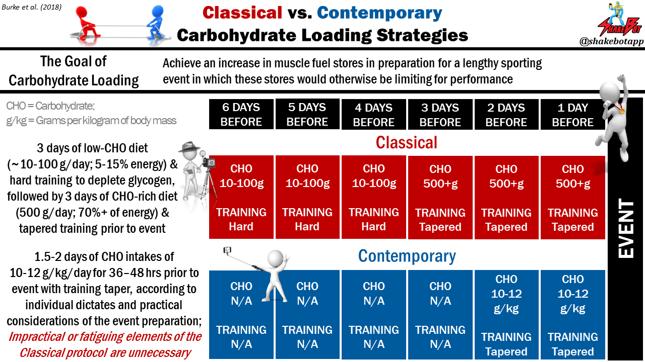
What is Carbohydrate Loading?
Carbohydrate loading or carbo-loading is a term used to describe a nutrition technique used by endurance athletes in an attempt to prolong optimal athletic performance and delay the onset of fatigue, or, ‘hitting a wall’.

Slide 20
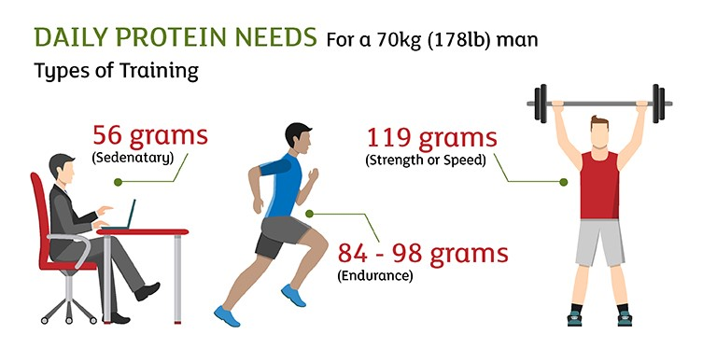
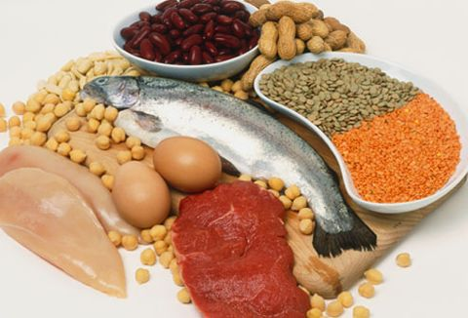
Protein and Exercise
Protein recommendations
  Adults: 0.8-1.0 grams per kg body weight
  Endurance athletes: 1.2–1.4 g/kg
  Resistance-trained athletes: 1.6–1.7 g/kg
Protein sources
  Animal source- Lean Meats, Fish, Low-fat Dairy, And Egg Whites
  Plant source- Tofu, Beans, Lentils, Green Peas, Nuts, Seeds, Whole Grains, Peanut Butter, White Button Mushrooms.
Protein intake after exercise
  Helps replenish glycogen
Dangers of high-protein intake
Notes:
20

Slide 21
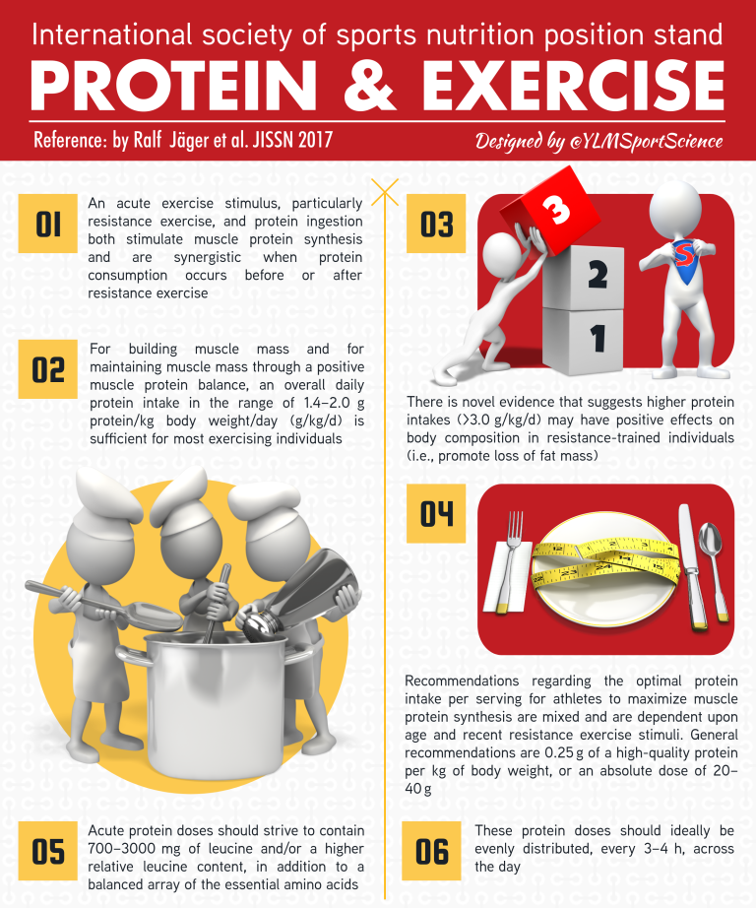
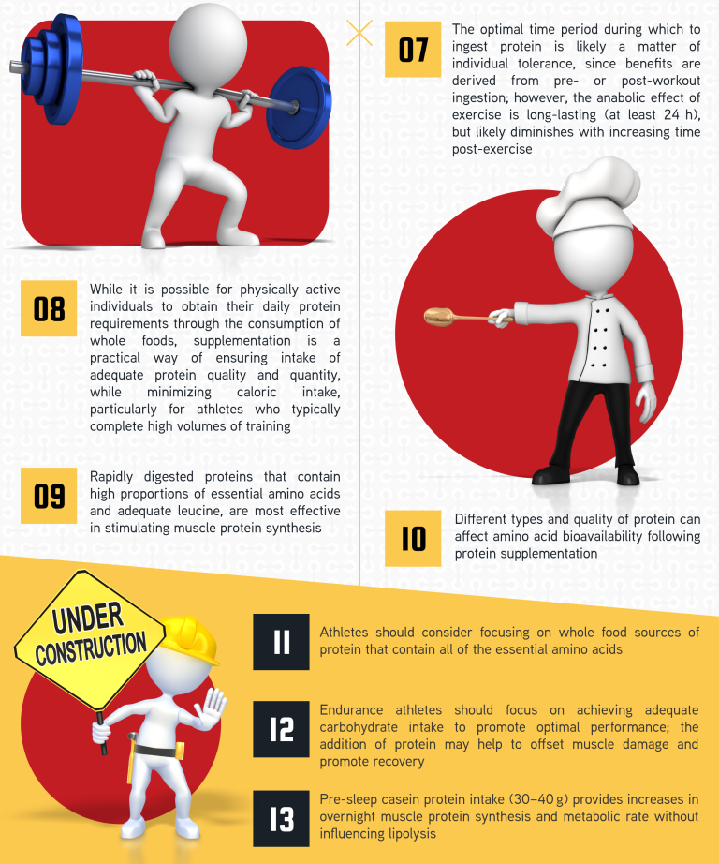

Slide 22
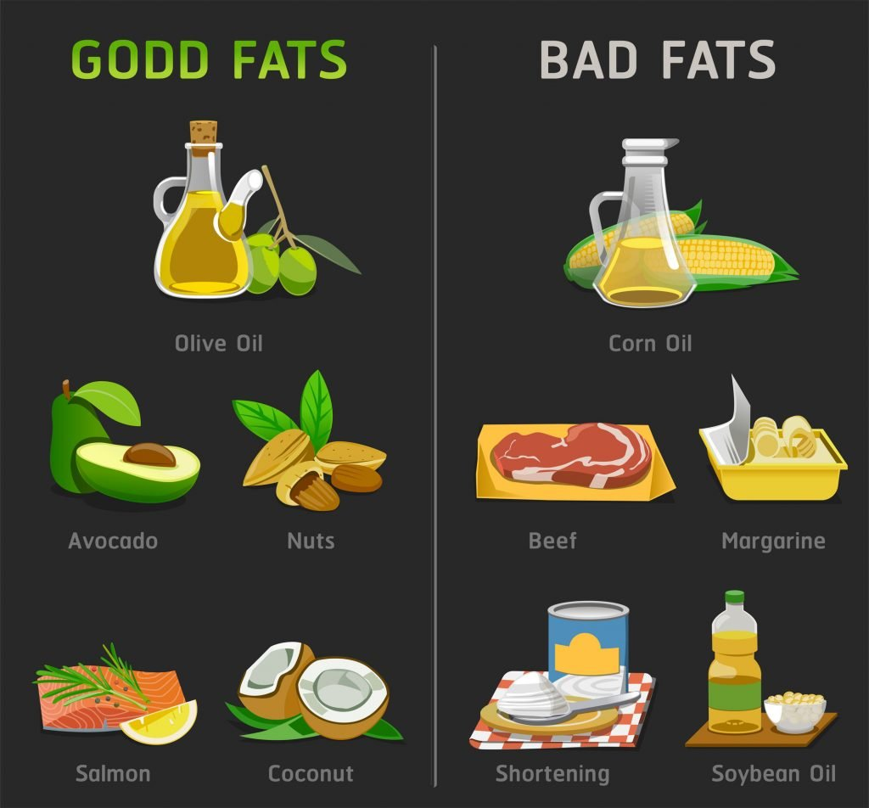
Dietary Fat and Exercise
Fat
  Major fuel source for endurance activities
  High-fat diet not needed
  Recommendations
    Moderate fat intake: 20–35% of calories
    Limit saturated fat to less than 10% of energy
    Avoid trans fat as much as possible
    Visible & Invisible fat ratio- 2:1
Notes:
22

Slide 23
Vitamins, Minerals, and Athletic Performance
B vitamins
  Needed for energy metabolism
  Choose variety of whole grains, fruits, and vegetables
  Vitamin C (400 to 3,000 mg/day)
  Vitamin C is important for connective tissue repair
  Vitamin C is also important to athletes because, as an antioxidant, it may help to reverse some of the oxidative damage that may occur from exercise
  Vitamin C promotes a healthy immune system and may help to prevent the dip in immune function that may occur right after exercise.
Notes:
23

Slide 24
Vitamins, Minerals, and Athletic Performance
Calcium (1500mg/d)
  Needed for normal muscle function and strong bones
  Low-fat dairy products
  Adequate intake may be a problem for females
Iron (women- 15 mg/day; Men- 10mg/day)
  Needed for RBC production, oxygen delivery and energy production
  Athletes have higher losses
  Sources- Lean red meats, vegetables, and enriched grains
Other trace minerals
  Copper and zinc
  Sodium & Potassium maintain
  Avoid high-dose supplements
Notes:
24

Slide 25
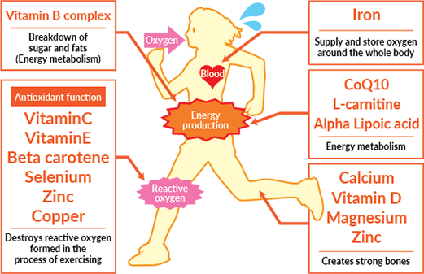

Slide 26
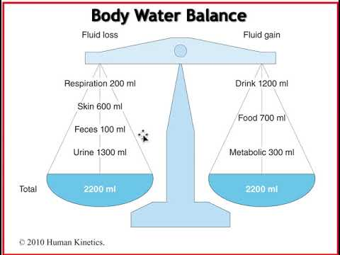
Fluid Needs During Exercise
Exercise and fluid loss
  Increased losses from sweat
  Increased with heat, humidity
  Risk for dehydration
The American Council on Exercise has suggested the following basic guidelines for drinking water before, during, and after exercise:
Drink 17 to 20 ounces of water 2 to 3 hours before you start exercising.
Drink 8 ounces of water 20 to 30 minutes before you start exercising or during your warm-up.
Drink 7 to 10 ounces of water every 10 to 20 minutes during exercise.
Drink 8 ounces of water no more than 30 minutes after you exercise.
*1 ounces = 29.57 mL
© PhotoDisc
Notes:
26

Slide 27
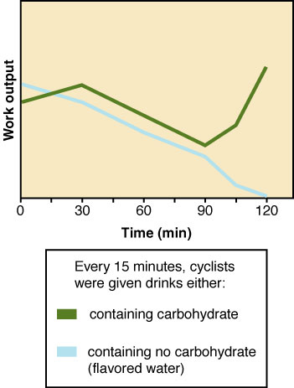
Fluid Needs During Exercise
Hydration
  Adequate fluids before,
  during, after exercise
  Water vs. sports drinks
    Duration
    Intensity
    Environmental factors
Notes:
27

Slide 28
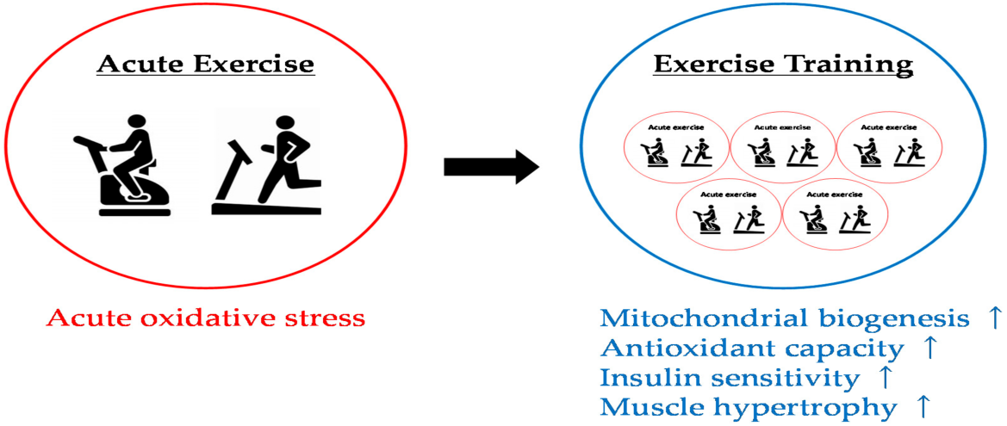
Antioxidants in Sport Nutrition
Antioxidant supplementation has become a common practice among athletes as a means to (theoretically) -
reduce oxidative stress,
promote recovery
enhance performance.
Higher dosages of antioxidants may not necessarily be beneficial in this context, but can also elicit detrimental effects by interfering with performance-enhancing.

Slide 29
Good sources of specific antioxidants
Allium sulphur compounds – leeks, onions and garlic
Anthocyanins – eggplant, grapes and berries
Beta-carotene – pumpkin, mangoes, apricots, carrots, spinach and parsley
Catechins – red wine and tea
Copper – seafood, lean meat, milk and nuts
Cryptoxanthins – red capsicum, pumpkin and mangoes
Flavonoids – tea, green tea, citrus fruits, red wine, onion and apples
Indoles – cruciferous vegetables such as broccoli, cabbage and cauliflower
Isoflavonoids – soybeans, tofu, lentils, peas and milk
Lignans – sesame seeds, bran, whole grains and vegetables
Lutein – green, leafy vegetables like spinach, and corn
Lycopene – tomatoes, pink grapefruit and watermelon
Manganese – seafood, lean meat, milk and nuts
Polyphenols – thyme and oregano
Selenium – seafood, offal, lean meat and whole grains
Vitamin A – liver, sweet potatoes, carrots, milk, and egg yolks
Vitamin C – oranges, blackcurrants, kiwifruit, mangoes, broccoli, spinach, capsicum and strawberries
Vitamin E – vegetable oils (such as wheatgerm oil), avocados, nuts, seeds and whole grains
Zinc – seafood, lean meat, milk and nuts
Zoochemicals – red meat, offal and fish. Also derived from the plants that animals eat.

Slide 30
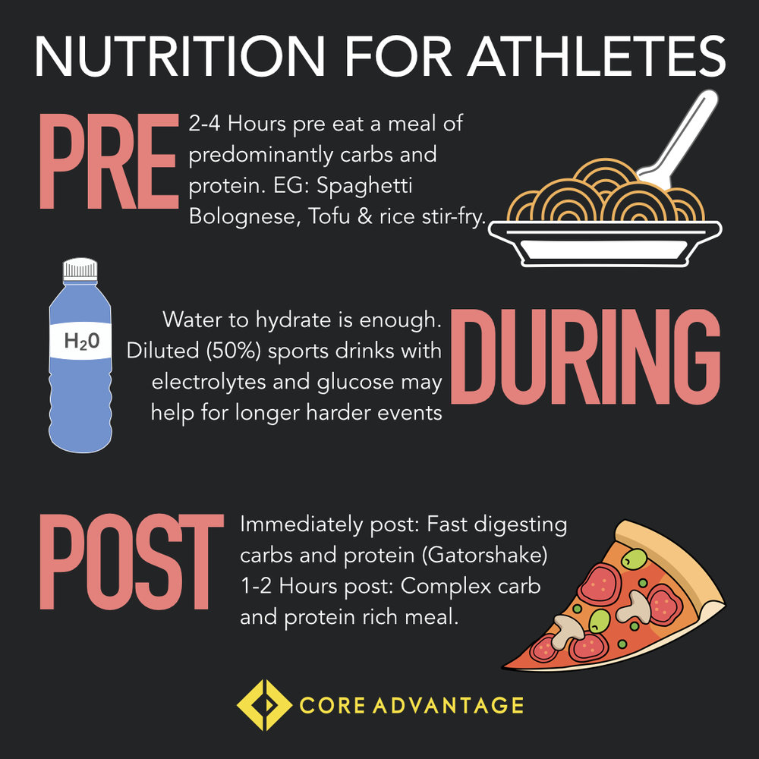

Slide 31
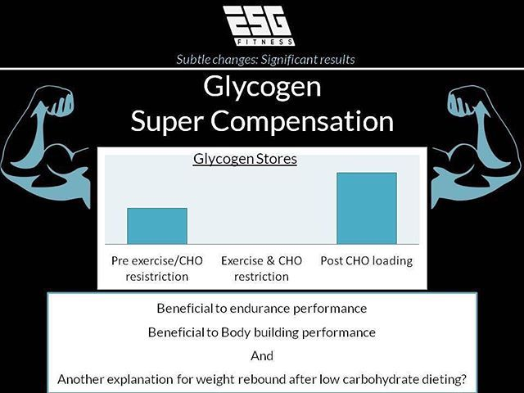
Glycogen supercompensation is when your muscles are able to hold a greater amount of glycogen than they normally would be able to. They will not only appear fuller and more pumped, but they will also have plenty of fuel to work hard.
Why Does It Work?
Glycogen normally draws water into the muscle, so if carbohydrates are consumed without excess water, water from underneath the skin will be pulled into the muscle. This is why bodybuilders who use glycogen supercompensation for a full, dry appearance at a competition normally choose dry carbohydrate sources.

Slide 32
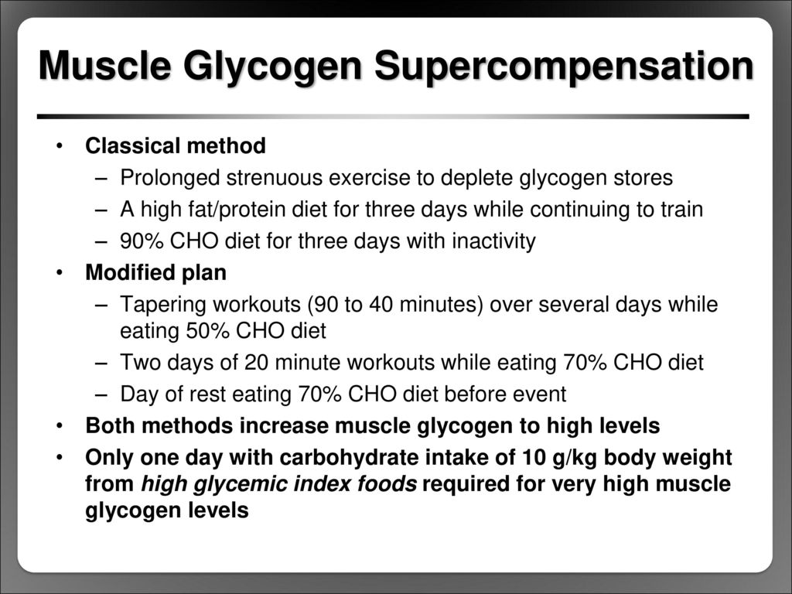

Slide 33


Slide 34


