Slide 1
POLIO
Introduction:-
Poliomyelitis is derived from two words:
Polio = Grey matter
Myelitis = Inflammation of the spinal cord
This disease result in destruction of motor neurons caused by poliovirus. Polio is causes by virus that attacks the nerve cells of the brain and spinal cord although not all infections result in severe injuries and paralysis.

Slide 2
What is Poliomyelitis ?
Poliomyelitis (polio) is an acute infectious viral disease caused by poliovirus, which mainly affects young children. The virus is transmitted through contaminated food and water and multiplies in the intestine, from where it can invade the nervous system.
This disease result in the destruction of motor neurons caused by the poliovirus.

Slide 3
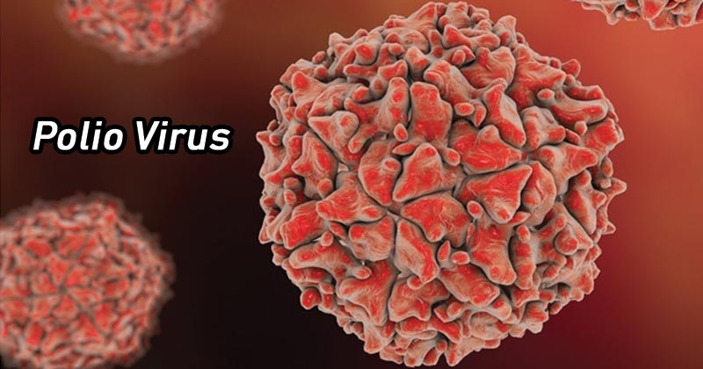
Name of Pathogen
Poliovirus, a member of the enterovirus subgroup of the
Picornaviridae family and
has three serotypes: PV1, PV2 and PV3.

Slide 4
Symptoms
Most people infected with the virus that causes polio, called poliovirus, don’t get symptoms.
Abortive polio
About 5% of people with the poliovirus get a mild version of the disease called abortive poliomyelitis. This leads to flu-like symptoms that last 2 to 3 days. These include:
Fever, Headache, Muscle aches, Sore throat, Stomachache, Loss of appetite, Nausea, Vomiting.
Nonparalytic polio
A more severe form of the disease, called nonparalytic polio, affects about 1% of those infected. While the illness lasts longer than a few days, it doesn’t cause paralysis. Besides having more-severe flu-like symptoms, nonparalytic polio symptoms may include:
Neck pain or stiffness, Severe headache, Aches or stiffness in the arms or legs.

Slide 5
A second phase of symptoms may follow, or a person may seem to be getting better for a few days before a second phase starts. These symptoms include:
Stiffness of the spine and neck, Decreased reflexes, Muscle weakness.
Paralytic polio
This most serious form of the disease is rare. The disease begins much like nonparalytic polio. But it progresses to more-severe signs and symptoms, including:
Intense pain, Extreme sensitivity to touch, Tingling or pricking sensations, Muscles spasms or twitching, Muscles weakness progressing to a limp paralysis.

Slide 6
Any combination of limbs may experience paralysis. But paralysis of one leg is most common, followed by paralysis of one arm.
Depending on the severity of disease, other signs or symptoms may include:
Paralysis of muscles involved in breathing, Difficulty swallowing
Post-polio syndrome
Post-polio syndrome is the appearance of new signs or symptoms or the progression of problems. This usually happens decades after having polio. Common signs and symptoms include:
Progressive muscle or joint weakness and pain, Fatigue, Muscle wasting, Breathing or swallowing problems, Sleep-related breathing disorders, such as sleep apnea, Lowered tolerance of cold temperatures.

Slide 7
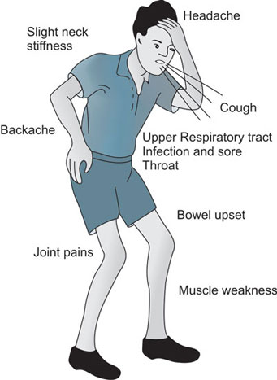
Subclinical Infection Symptoms
Headache
Slight fever
Vomiting
General discomfort back pain and neck pain
Leg and muscle pain

Slide 8
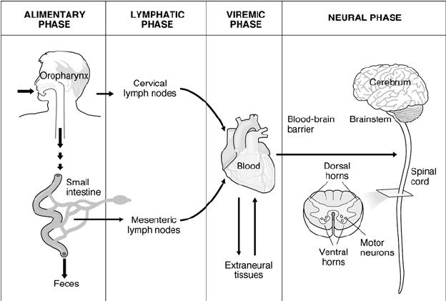
Pathogenesis
Enter through mouth
Multiplies in oropharynx tonsil and intestine,
Excreted in stool,
Enter the CNS from blood,
Spread along the Axon of peripheral
nerves to CNS,
Progress along the fibers of the lower
Motor neurons spinal cord or brain.

Slide 9
Destroy the anterior horn cells of the Spinal Cord.
Do not multiply in the muscle only
muscle manifest with
weakness and flaccid paralysis
result is secondary.
Occasionally produce :
Myocarditis, Lymphatic hyperplasia.

Slide 10
Mode of Action
This disease transmitted by droplet infection and by oral ingention. The virus is transmitted by person-to-person spread mainly through water or food contaminated by faeces.
Incubation period
The period of incubation varies from 3 to 30 days.

Slide 11
Prevention
The best preventive measure for Poliomyelitis is ensuring hygiene and encouraging good sanitation practices. But, polio prevention begins with polio vaccination. Polio vaccine has been developed against all 3 subtypes of the poliovirus and is very effective in producing protective antibodies that induces immunity against the poliovirus and provides protection from paralytic polio.

Slide 12
THANK YOU

